Slide 1
Authentication: Comparative Study
CS573 – GROUP 2
Michael Fang 10430930
Chunli Liu 10430963
Janiece Pandya 10431583
Disha Sareen 10429086
Siddhant Barua 10439929

Slide 2
Contents
Blockchain based trust & authentication for decentralized sensor networks (Chunli Liu)
Passwordless Authentication (Janiece Pandya)
Biometrics for Authentication (Disha Sareen)
Applications of Computer Vision in Authentication. (Siddhant Barua)
DNA Authentication and Encryption (Michael Fang)

Slide 3
Blockchain based trust & authentication for decentralized sensor networks
by: CHUNLI LIU

Slide 4
Blockchain based trust & authentication for decentralized sensor networks
what is blockchain:
Blockchain is an integrated multi- eld infrastructure construction, the technologies contain Cryptography, mathematics, Algorithm and economic model, combining peer-to-peer networks, and using distributed consensus algorithm to solve traditional distributed database synchronize problem.
Notes:
there are many use case of blockchain technologies, for example, digital currency:Bitcoin, smart contract and Hyperledger and so on.

Slide 5
Blockchain based trust & authentication for decentralized sensor networks
from the point of security:
Comparing with centralized controllers who are prone to attacks, blockchain is a secured, shared and distributed ledger that facilitates the process of recording and tracking resources without the need of a centralized trusted authority.
Notes:
ex: Bitcorn has proposed a new decentralized and evolutive way to model and acknowledge trust and data validity in a peer network by the mean of the blockchain.

Slide 6
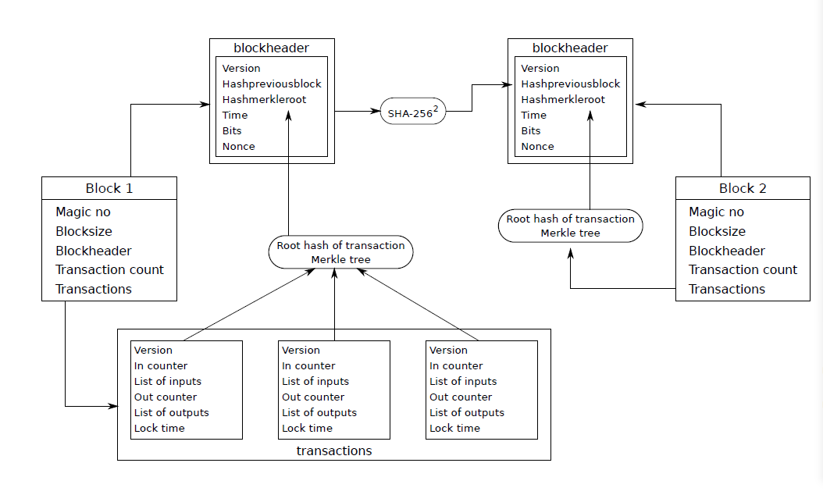
Bitcoin block chaining mechanism
Notes:
linear sequence blocks, each blocks containing cryptographic hashes,
Merkle root of all transactions is included in the block header and then used as input for the next
block in the chain.

Slide 7
Why BATM
replying
Blockchain is decentralized
no single node which can assure to be connected at every moment of the network life
a RESTful model is designed for interaction with network to ensure proper organization and content management in decentralized networks.

Slide 8
pre-requisite of BATM
network service model
G = (V,E) (Vertex describing a Node, Edge links two nodes)

Slide 9
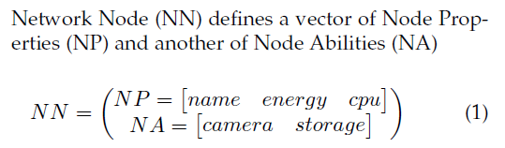
Network services model:
Network Node (NN) defines a vector of Node Properties (NP) and another of Node Abilities (NA)
Notes:
before moving to blockchain based model, we firstly define the network model we use: network service model
each vertex describing a node in the network, and each edge links two nodes within transmission range from each other.
NN means network node, NP means network properties, NA means network abilities.

Slide 10
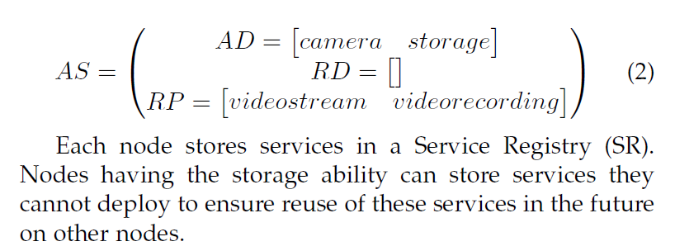
Network services model
Notes:
Abilities Dependencies (AD) vector, a Resources Dependencies(RD) vector, and a Resources Provider (RP) vector, they are all defined by Available Services (AS)

Slide 11
Blockchain authentication and trust module(BATM)
BATM associates cryptographic keys with each NN and AS in the network

Slide 12
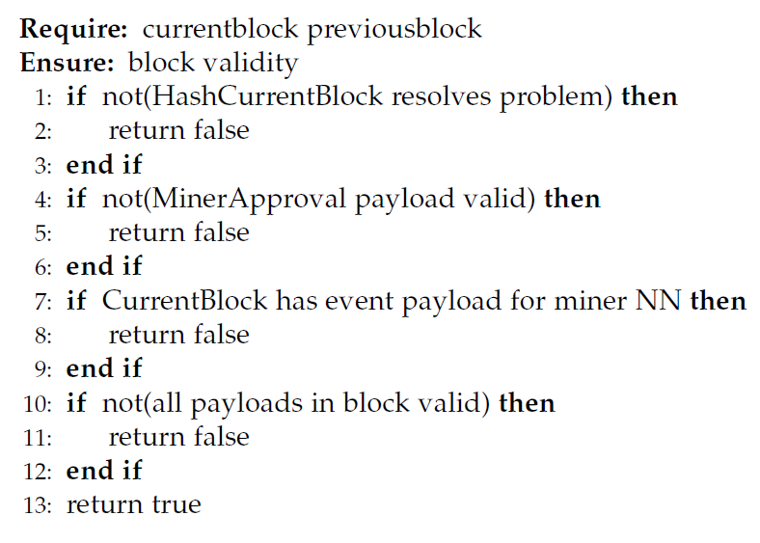
Block validity check algorithm

Slide 13
BATM trust management
why we don’t need a trust center?
payloads contained in the blockchain as an indication of each node behaviour on the network over time
In This way, we ensure a node cannot fool others by tampering data or pretending to be someone else.
Thus we ensure reliability of trust evaluation without the need of a trust center.
Notes:
At authentication, a node submits a credential payload containing its master public key along with secondary keys. We ensure key renewal to mitigate attacks known for guessing keys by using key validity timeouts. As network security and privacy relies on informations contained in the blockchain, it means that only authenticated nodes can mine new blocks.

Slide 14
BATM payload rules
Why we need to define rules for payload?
BATM with HKT provide a powerful solution to authenticate nodes and evaluate trust in decentralized networks.
The system can be made instable by malicious authenticated nodes overloading the network and submitting lots of valid payloads for inclusion in the blockchain.
so, To overcome this issue, we define specific rules for payload submission in the network to improve stability of the system over time.

Slide 15
BATM
future work
To evaluate each part of BATM completely with the objective of more adaptative algorithms taking AS and NN characteristics as defined in our model.(Axel Moinet, Benoit Darties, and Jean-Luc Baril)

Slide 16
Real world testing
If simulation results fullfill our expectations, BATM will be included in Multicast Services for Linux (MSL), an implementation our SOA network model. Note that MSL is at development stage for now with now release date.
Moreover, MSL is intended to be used as a real world proof of concept for our overall design including SOA model and BATM with HKT.
Notes:
each vertex describing a node in the network, and each edge links two nodes within transmission range from each other.
NN means network node, NP means network properties, NA means network abilities.

Slide 17
BATM
conclusion
Notes:
This paper proposes a new application for the blockchain as a secured decentralized storage for cryptographic keys as well as trust informations in the context of autonomous Wireless Sensor Networks. The Blockchain Authentication and Trust Module and its Human-like Knowledge based Trust model shows how to use to immutability of the blockchain to provide solutions to high problematics in the field of decentralized ad-hoc networks. More precisely, we show how it is possible to build a complete solution providing authentication mechanisms as well as trust evaluation in a self-organized and evolutive network.

Slide 18
Works Cited
[1] C. M. Medaglia and A. Serbanati, An Overview of Privacy and Security Issues in the Internet of Things, D. Giusto, A. Iera, G. Morabito, and L. Atzori, Eds. New York, NY: Springer New York, 2010.
[2] Y. L. Sun, Z. Han, W. Yu, and K. R. Liu, “A trust evaluation framework in distributed networks: Vulnerability analysis and defense against attacks.” vol. 2006, pp. 1–13, 2006.
[3] G. Zyskind, O. Nathan, and A. S. Pentland, “Decentralizing privacy: Using blockchain to protect personal data,” Proceedings - 2015 IEEE Security and Privacy Workshops, SPW 2015, pp. 180–184,
2015.
[4] N. Fotiou and G. C. Polyzos, “Decentralized name-based security for content distribution using blockchains,” Proceedings - IEEE INFOCOM, vol. 2016-September, pp. 415–420, 2016.
[5] S. Nakamoto, “Bitcoin: A Peer-to-Peer Electronic Cash System,” www.bitcoin.org, p. 9, 2008. [Online]. Available: https://bitcoin.org/bitcoin.pdf
[6] I. Eyal, A. E. Gencer, E. G. Sirer, and R. Van Renesse, Bitcoin-ng: A scalable blockchain protocol, 2016.
[7] B. Solhaug, D. Elgesem, and K. Stolen, “Why trust is not proportional to risk,” pp. 11–18, 2007.
[8] T. Erl, Service-oriented architecture: concepts, technology, and design.Pearson Education India, 2005.
[9] Z. Shelby, K. Hartke, and C. Bormann, “The constrained application protocol (coap),” Standard Track, Internet Engineering Task Force (IETF), 2014.
[10] S. De, P. Barnaghi, M. Bauer, and S. Meissner, Service modelling for the Internet of Things,2011.
[11] P. R. Zimmermann, The official PGP user’s guide. MIT press, 1995.
[12] J. Callas, L. Donnerhacke, H. Finney, D. Shaw, and R. Thayer,“Rfc 4880 - openpgp message format,” Proposed Standard, Internet Engineering Task Force (IETF), 2007.
[13] D. Gambetta, “Can we Trust Trust?” Trust: Making and breaking coopeative relations, pp.213–237, 1990.
[14]International Journal of Network Security, Vol.19, No.5, PP.653-659, Sept. 2017 (DOI: 10.6633/IJNS.201709.19(5).01)

Slide 19
Passwordless
Authentication
Beyond Passwords: The Future of Authentication

Slide 20
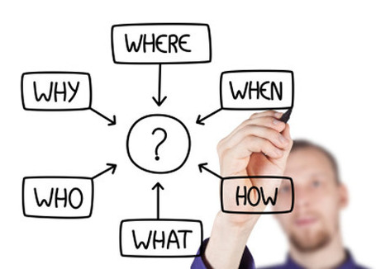
The WH Questions….

Slide 21

What is “Passwordless Authentication”?
Passwordless authentication is any method of verifying the identity of a user that does not require the user to provide a password.
Passwords are no longer enough.
With this form of authentication, users are presented with the options of either logging in simply via a magic link, fingerprint, or using a token that is delivered via email or text message.
Out with the Old --- In with the new.

Slide 22
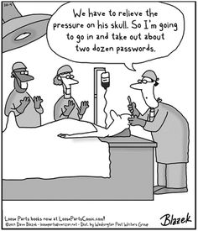
When was this idea developed?
"There is no doubt that over time, people are going to rely less and less on passwords. People use the same password on different systems, they write them down and they just don't meet the challenge for anything you really want to secure." - Bill Gates, RSA Conference 2004
Identity Protection is the need of the hour.
81% of hacking-related breaches leveraged either stolen and/or weak passwords out of which 60-63% breaches were due to password leaks.
If you’re one of those people who think it won’t happen to you, then it probably already has.

Slide 23
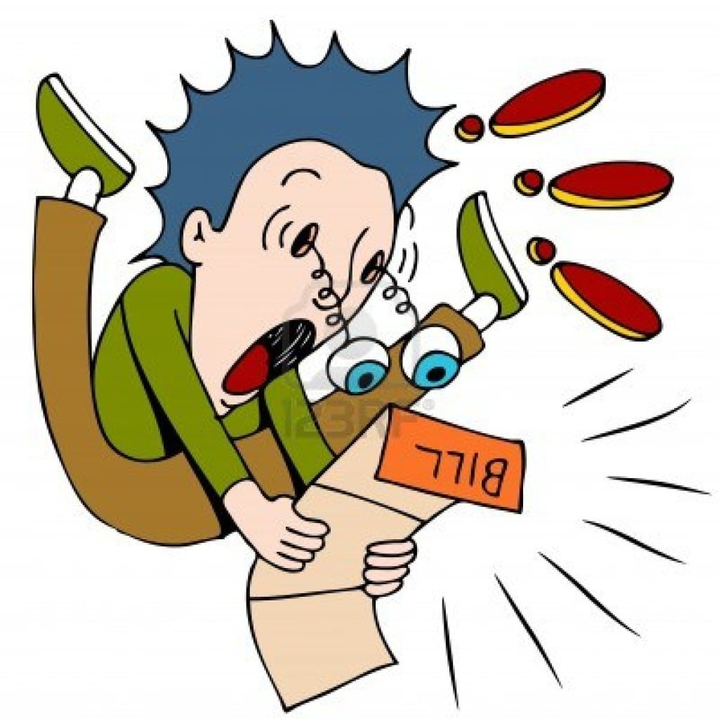
Estimated Cost Analysis for Enterprise IT Departments
For Microsoft Account in the month of July 2017.
686K people forgot their passwords
$12M+ spent on forgotten passwords

Slide 24
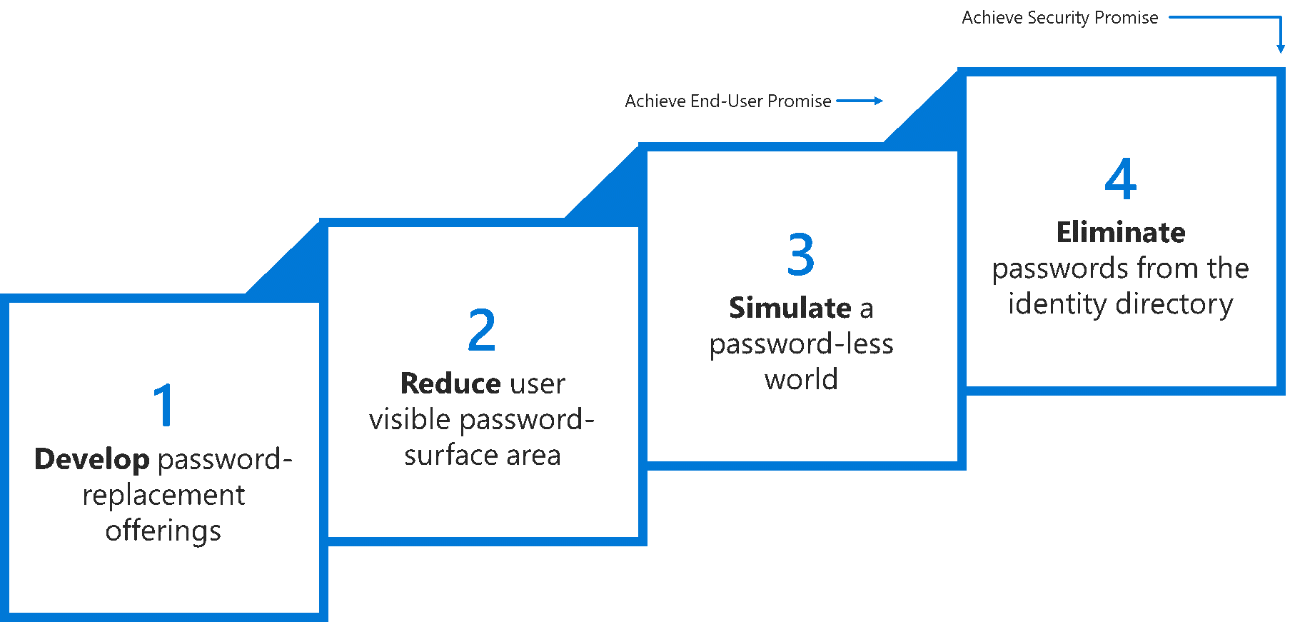
Ideologies while adopting Passwordless Strategy
A world without passwords should be delivered on two key-promises:
User promise: End-users should never have to deal with passwords in their day-to-day lives.
Security promise: User credentials cannot be cracked, breached, or phished.

Slide 25
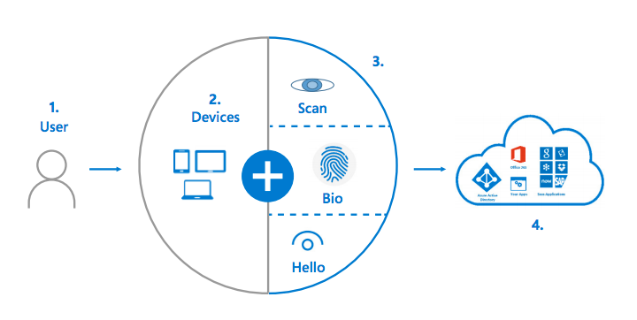
Where it works?
Authentication with Asymmetric Public/Private Key Pair :
Magic Link via Email
One Time Code via Email
One Time Code via SMS
Biometrics

Slide 26
How it works?
The user attempts to sign into their account from a device. The device sends an authentication request. The identity system requests validation by sending nonce and asking the device to sign it with it’s private key.
The user interacts with a local gesture (for example, biometric, PIN) from its device. The device uses the private key to sign nonce and returns to Identity Provider with key ID. A request/ signature containing both the nonce + the key ID signed with the device key sent to Identity Provider.
Identity Provider verifies the signature with the public key in the user object and verifies nonce. Builds a Primary Refresh Token and an ID token and send them back along with an encrypted session key. The user accesses applications without the need of authenticating again.

Slide 27
Why it is used?
End-users should never have to deal with passwords in day-to-day life.
More Secure
Ease-of-use and Convenience without high-security risks.
Desk-costs can be reduced. Easy to deploy.
Improved user experience.
Drawbacks
Dependency in availability - if their system is down, your login won’t work.
Educating users about this new technology can be difficult sometimes.
Only compromised systems are prone to attacks.

Slide 28
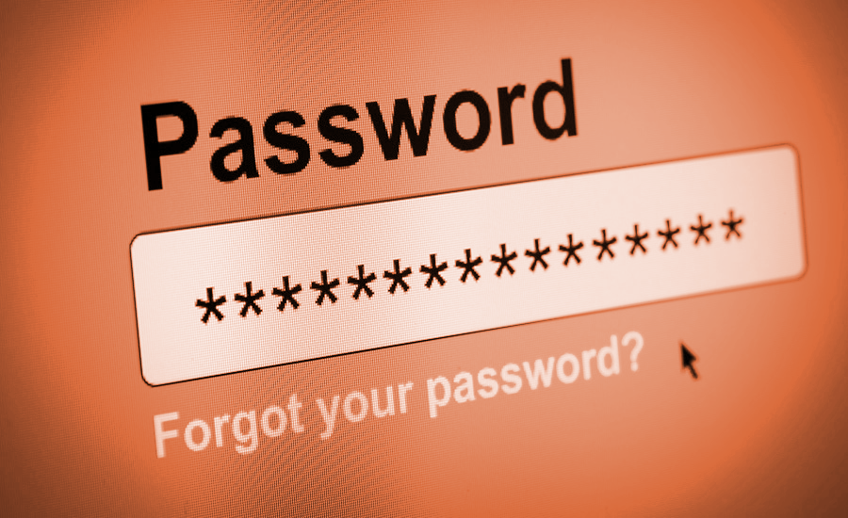
Who uses it?
Windows Hello for Business (Windows 10)
Microsoft Authenticator App
Duo Security (Stevens Workday System)
Auth0 Universal Login
Forget

Slide 29
Conclusion
Going passwordless is a long-term approach for secure authentication, and it’s still evolving. It can take time to transition.
For users that can’t go password-less, turn on MFA to validate users and minimize prompts based on the risk of the sign-in with conditional access capabilities.
Latest Approach: On April 10, 2018 the World Wide Web Consortium (W3C) and FIDO Alliance announced the promotion of the WebAuthn spec to the “Candidate Recommendation” stage, the precursor to the final approval of a web standard and the W3C has invited online services and web app developers to implement WebAuthn.

Slide 30
Citations
https://query.prod.cms.rt.microsoft.com/cms/api/am/binary/RE2KEup
http://jasonmun.com/wp-content/uploads/2013/03/6ws.jpg
https://dzone.com/articles/how-passwordless-authentication-works
https://www.tracesecurity.com/blog/articles/81-of-company-data-breaches-due-to-poor-passwords
https://www.forbes.com/sites/forbestechcouncil/2018/06/04/the-future-of-authentication-is-here/#722d734d432e
https://www.okta.com/blog/2018/04/its-a-new-world-with-webauthn-passwordless-authentication-goes-primetime/
https://ieeexplore.ieee.org/document/8029677/references#references
https://www.sitepoint.com/passwordless-authentication-works/
https://dzone.com/articles/how-passwordless-authentication-works
https://doubleoctopus.com/security-wiki/authentication/passwordless-authentication/
https://www.pingidentity.com/en/company/blog/2017/10/03/achieving_secure_passwordless_authentication.html
https://www.tracesecurity.com/blog/articles/81-of-company-data-breaches-due-to-poor-passwords
https://www.theguardian.com/technology/2019/jan/17/breached-data-largest-collection-ever-seen-email-password-hacking
https://nakedsecurity.sophos.com/2018/11/22/the-passwordless-web-explained/
https://auth0.com/docs/getting-started/overview
https://www.microsoft.com/security/blog/2018/05/01/building-a-world-without-passwords/
https://www.w3.org/2018/04/pressrelease-webauthn-fido2.html.en
https://channel9.msdn.com/Events/Ignite/Microsoft-Ignite-Orlando-2017/BRK2078

Slide 31
Biometrics for Authentication

Slide 32
Introduction
Biometrics are a way to measure a person’s physical characteristics to verify their identity.
These can include physiological traits, such as fingerprints and eyes, or behavioral characteristics, such as the unique way you'd complete a security-authentication puzzle.
We are going to cover Fingerprint Recognition.
Notes:
Biometric is derived from 2 greek words:
Bios and Metron meaning measurement of life.

Slide 33
Checklist for Biometric features
UNIVERSALITY
SAFE AGAINST CIRCUMVENTION
UNIQUENESS
MEASURABILITY
PERMANENCE
Notes:
• Universality: All people possess the feature.
• Uniqueness: The feature is different for people so the system can distinguish between them.
• Permanence: The feature only varies slightly over time.
• Measurability: The system can acquire and process the feature in an efficient way.
• Safe against circumvention: The system can distinguish between the real feature and a dummy

Slide 34
More on Biometrics Authentication
The biometric information is read, stored, & is made available for comparison with “live” information.
PHYSICAL COMPONENTS:
01
SENSOR
This is what records your information, as well as reads it when your biometric information needs to be recognized.
02
BIOMETRIC APPLICATION
There has to be a computer system to compute & compare features
03
DATABASE
The database is required to store the biometric templates.
Notes:
https://us.norton.com/internetsecurity-iot-biometrics-how-do-they-work-are-they-safe.html
https://www.usenix.org/system/files/conference/woot18/woot18-paper-fietkau.pdf

Slide 35
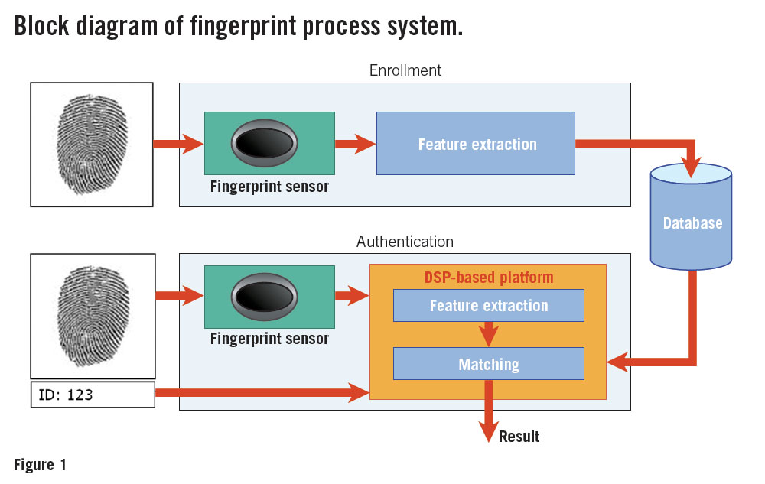
Biometric Authentication contd.
Enrollment
Verification/Authentication
Notes:
Enrollment : During enrollment, each person's fingerprints/Face’s are scanned, analyzed, and then stored in a coded form on a secure database.
Verification: The scanner takes their biometric, checks it against all the templates in the database stored during enrollment, and decides whether the person is entitled to gain access or not. Sophisticated biometric systems can verify and match up to 40,000 prints per second!
://www.androidauthority.com/how-fingerprint-scanners-work-670934/
https://www.explainthatstuff.com/fingerprintscanners.html
https://semiengineering.com/fingerprint-senor-technology-and-security-requirements/

Slide 36
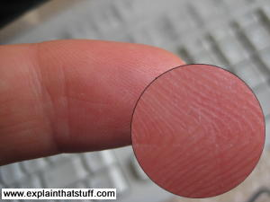
Fingerprint Authentication
Captures the unique pattern of ridges and valleys on a finger.
Eg: Apple’s Touch ID
Numerous applications: Civilian and commercial applications like military, law enforcement, medicine, education, civil service, forensics, driver license registration, cellular phone access, computer log-in and so on.
Notes:
https://www.usenix.org/system/files/conference/woot18/woot18-paper-fietkau.pdf

Slide 37
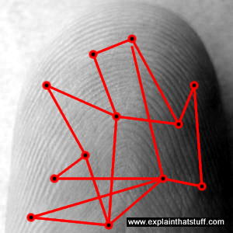
Fingerprint Authentication contd.
During enrollment or verification, each print is analyzed for very specific features called minutiae, where the lines in your fingerprint terminate or split in two.
The computer measures the distances and angles between these features—a bit like drawing lines between them—and then uses an algorithm to turn this information into a unique numeric code.
Comparing fingerprints is then simply a matter of comparing their unique codes. If the codes match, the prints match, and the person gains access.
Notes:
https://www.explainthatstuff.com/fingerprintscanners.html

Slide 38
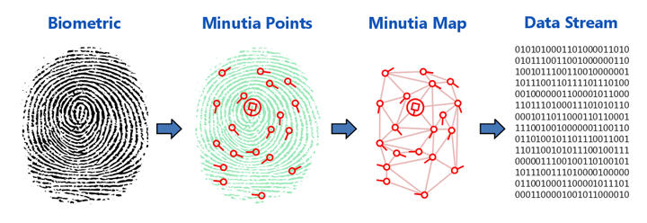
The Data Process

Slide 39
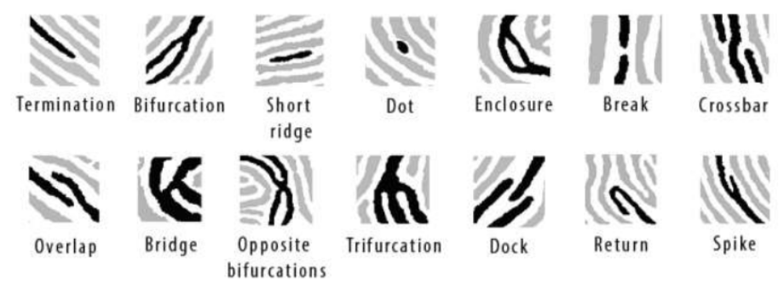
Some possible minutia features in fingerprint classification

Slide 40
Pros & Cons of Biometrics for Security
PROS Can’t Fake it (Highly difficult) Convenience is Key Role in 2FA Reliable in Authentication | CONS Privacy at Risk Feels Invasive Injury & Illness Common across multiple systems Cannot reset or revoke
Notes:
Can’t Fake It Employee identification cards, time cards, or employee numbers can all be copied or faked. However, when it comes to biometrics, faking it is much more difficult. Biometric input is unique for each individual—each person has a unique fingerprint, retina, and face. This information would be difficult to forge without the person’s body part.ing Option
Convenience Is Key Biometrics offers a level of convenience over traditional security methods. For example, when following best practices—using symbols, numbers, changing every 3 months—passwords are not very convenient. To protect your information, you need a complex password, which can be difficult to remember. Also, using the same password for multiple sites isn’t secure, so you must keep track of numerous complex passwords. Using biometric technology allows you—and only you—to access your data easily and conveniently.
Two-Factor Authentication Another pro for biometric technology is its use in two-factor authentication (2FA). As a result of increasing security risks, many companies are implementing regulations that require all staff to use 2FA to log in and access all vital or sensitive information. A secure password is commonly step one, and the use of a biometric security feature is an effective step two. This second layer of security creates an additional barrier or protection and decreases the odds of hackers infiltrating the server or system.
CONS:
Privacy at Risk?
Some users feel that biometric technology puts their privacy at risk. With biometric data stored on a security system or scanner, there is a risk of serious consequences should the servers storing the information fall to hackers. These types of breaches are not unheard of and have happened in the past. And, unlike passwords that can be changed, fingerprints and other biometric data are unique and once hacked or stolen, are at a high risk to be used again.
Feels Invasive
User acceptance is another con against the use of biometrics for security. Employees or individuals who are uncomfortable with the idea of using biometrics often see the practice as invasive. Some are uneasy or are not comfortable with using their personal features as part of the company’s security network or having their biometric information stored. Security that is invasive can be considered an intrusion on personal rights. As an alternative, companies may need to consider a secondary means of security for these employees.
Injury and Illness
Another con to the use of biometrics for security is that they rely so strictly on the uniqueness of the biometric property. What happens in the case of illness and injury? Do these affect the ability of a person to access their information when protected by biometric security? For example, have you ever lost your voice from a bad cold or tonsillitis? Have you ever had a bad case of pink eye? What about slicing your finger on a sharp knife? Does this injury change the surface of your skin enough that your fingerprint is unreadable? Biometrics relies on the unique, precise identifying markers of these body parts. What happens if they’re unreadable?
https://it.toolbox.com/blogs/carmashoemaker/pros-and-cons-of-biometrics-for-security-053118

Slide 41
Applications of Computer Vision in Authentication.
Intersection between biometrics and computer vision.

Slide 42
What is Computer Vision?
Computer vision is defined as a field of study that essentially helps computers "see" and understand the content of digital images such as photographs and videos.
Notes:
The goal of computer vision is to understand the content of digital images. Typically, this involves developing methods that attempt to reproduce the capability of human vision.
The difference between image processing and computer vision is that
Image processing is the process of creating a new image from an existing image, typically simplifying or enhancing the content in some way.

Slide 43
Vision is trivial for humans.
Human beings have inbuilt depth perception.
Human beings can make relations between visual events.
Human beings can recognize faces i.e. other humans.
Vision is not so trivial to implement.
Primarily reason is that we don’t have a strong grasp of how human vision works, in terms of how images are processed and relations are made in the brain.

Slide 44
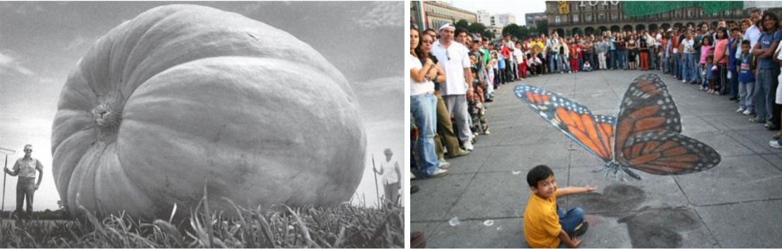
Vision is hard
Notes:
A 2D image produces a 3D effect, Field of view can play tricks on our eyes.

Slide 45
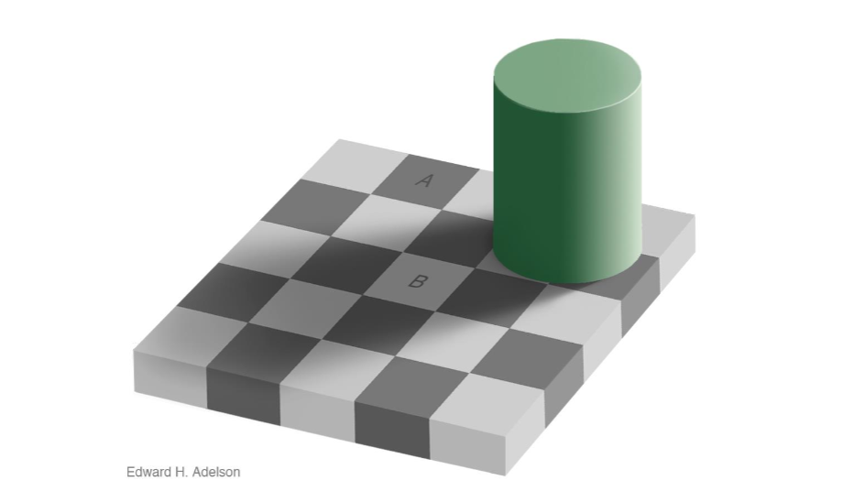

Vision is hard

Slide 46

Vision is inferential

Slide 47
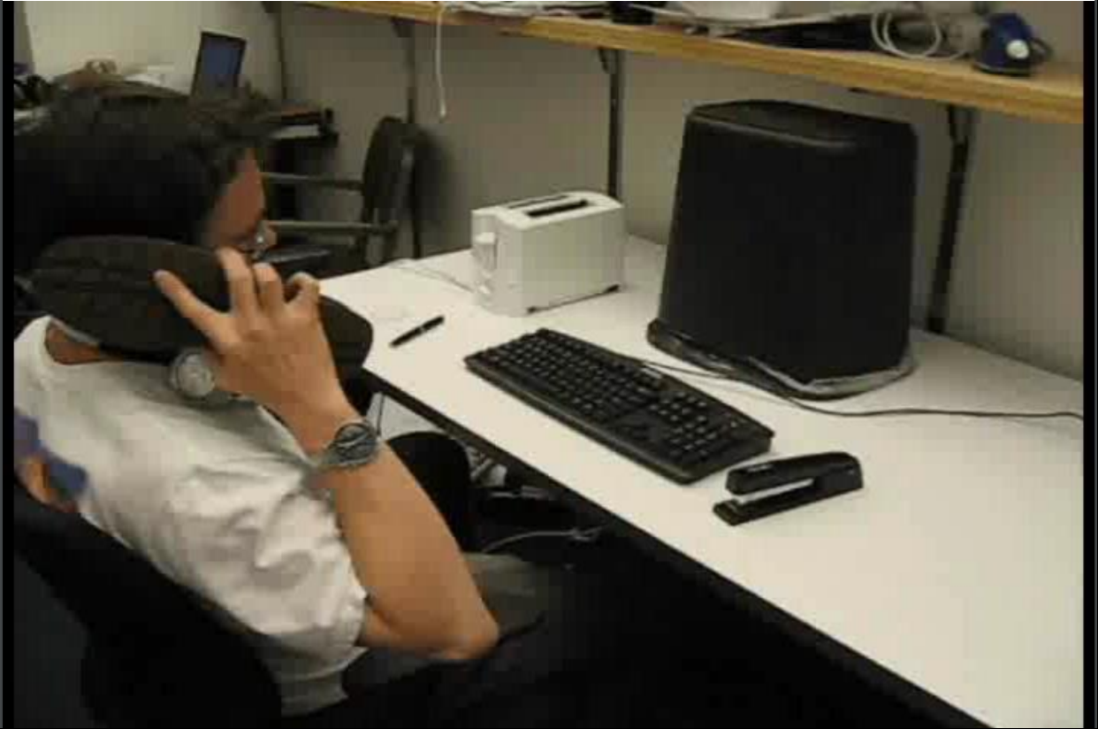
Vision is inferential

Slide 48
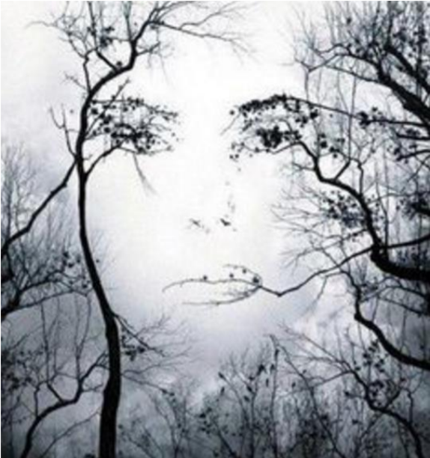
It’s also fascinating
Notes:
Recognized as a face in most facial detection algorithms even though it's a landscape picture of trees in a forest.
Images are 2 dimensional, human existence is 3 dimensional , hence when an image of a 3d space is captured it is translated to 2d and during this conversion, depth is ignored. This leads to strange anomalies of images like this.

Slide 49
Why vision is hard ?
Image colors depend on surface properties, illumination, camera response function and interactions such as shadows.
Noise.
Conversion of an image in a 3d space to a 2d space - this leads to loss of certain properties like depth.
Lots of data.
Conflicts among local and global cues.
Notes:
After having established what vision is, and taking into account their respective challenges, we move on to what the applications for Computer vision might be for authentication and security.

Slide 50
Unique aspects of humans
RETINA✅
IRIS ✅
EAR ✅
FINGER PRINT ✅
Notes:
The process or action of verifying the identity of a user is authentication
and how is this done? By finding certain aspects of human beings that are unique i.e. cannot be stolen at least not without physical force.
TONGUE - Can’t lick the phone
VOICE - Can be used but is not in the scope of this presentation. Also any commedian worth his salt can impersonate the president.
TOE - Not exactly feasable DUHH
TEETH, LIP - Not useable due to degree of luminousity inside mouth.
GAIT - who even know’s what that means.

Slide 51
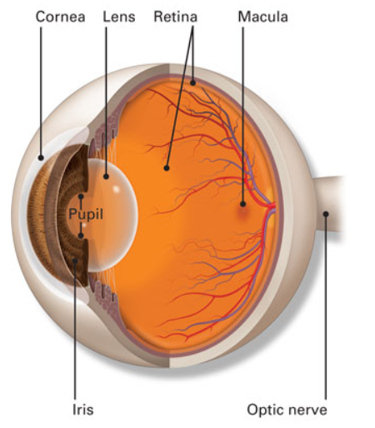
RETINA SCAN
A retinal scan is used to map out the unique patterns of a person's retina.
A low-energy infrared light is passed onto a person's eye as they look through the scanner's eyepiece.
The blood vessels within the retina absorb light more readily than surrounding tissues, this leads to variation in the amount of reflection of the infrared light.
The pattern of variations is converted to computer code and stored in a database for authentication purposes.
Notes:
The human retina is a thin tissue composed of neural cells located in the posterior portion of the eye.
Complex structure of blood capillaries that is unique to every person. So much so that even identical twins don't share the same structure.
May alter when a person has AIDS, diabetes, glaucoma or retinal degeneration.

Slide 52
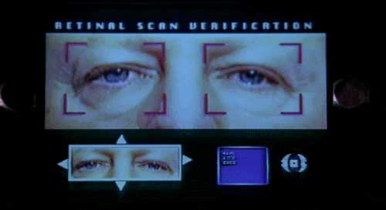
RETINA SCAN

Slide 53
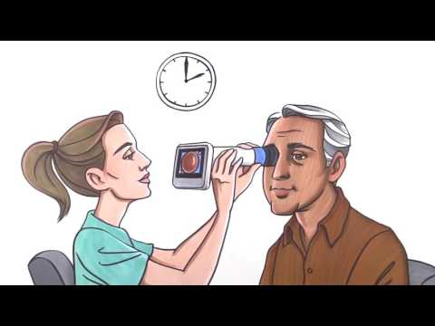

Slide 54
Pros and Cons of Retinal Scan
High level of accuracy
Low occurrence of false positives
Most accurate method of biometrics
Reliable due to the fact that retina capillary structures doesn't change over a lifetime.
No two individuals share the same retinal pattern
Diseases, and genetic birth defects can affect accuracy.
High costs
Need of very specific equipment, requiring the person's eye and the camera to be parallel to the ground , to get maximum coverage of the retinal pattern .
Perception of invasiveness.

Slide 55
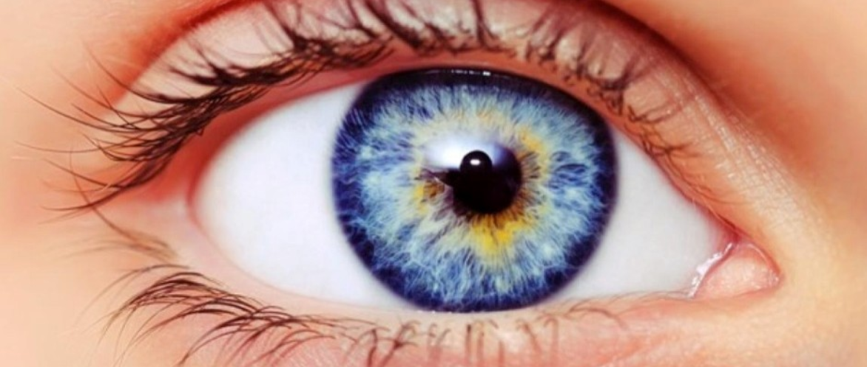
IRIS SCAN
Iris recognition uses camera technology with subtle infrared illumination to acquire images of the detail-rich, intricate structures of the iris.
Digital templates are encoded from these patterns by mathematical and statistical algorithms allow unambiguous positive identification of an individual.
Databases of enrolled templates are searched by matcher engines at speeds measured in the millions of templates per second per (single-core) CPU, and with infinitesimally small False Match Rates
Iris
Pupil
Notes:
Thin, circular structure in the eye, responsible for controlling the diameter and the size of the pupils and thus the amount of light reaching the retina.
Mostly used for mobile authentication, passport-free automated border-crossings, and some national ID systems based on this technology are being deployed.

Slide 56
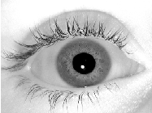
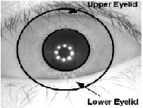
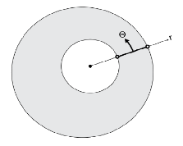
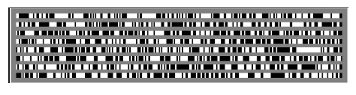
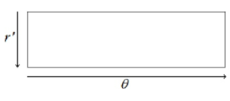
High Level overview of how it works
Image Acquisition
Iris Localization
Normalization
Unwrapping
Encoding
Notes:
Iris localization is done using Canny Edge Detector Algorithm
Normalization and Unwrapping are done using Dauggman’s rubber sheet model.
Encoding is done using Garbour Filter.

Slide 57
Pros and Cons of Iris Scan
Accuracy.
Scalability.
Distance isn’t as big a factor as compared to Retinal Scans.
Non Intrusive.
No two individuals share the same Iris encoded pattern.
Subject needs to be steady.
Glossy eyes, leads to reflection.
A lot of memory is required to detect the iris pattern and store it.
High cost.
Notes:
The capillaries in the iris and retina decompose too rapidly to use a amputated eye to gain access

Slide 58
Ear Scan
Each individual has a unique pair of ears.
As evinced by IANNARELLI, A. 1989. Ear Identification, Forensic Identification Series. Paramount Publishing Company, Fremont, CA.
Is 2 factored by design (i.e. Visual cues + acoustics).
Not very widely used.
Notes:
10,000 random subjects in california , and each of them had separate set of ears despite them being similar, they are not the samer

Slide 59
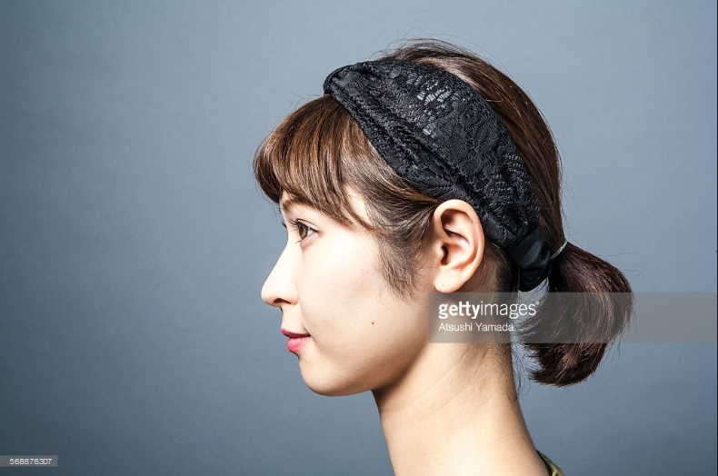
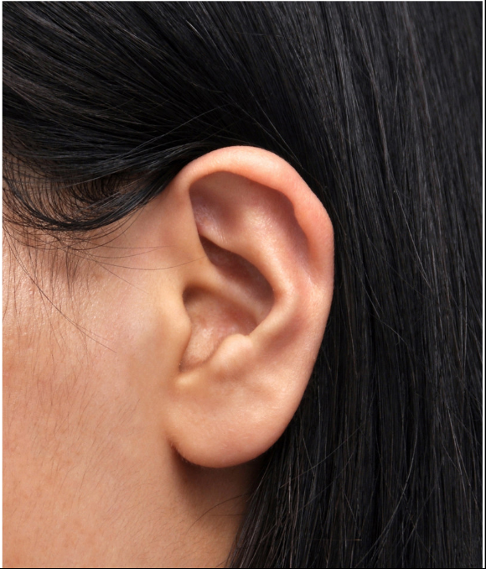
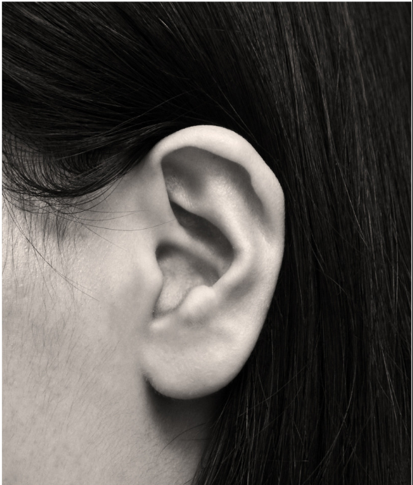
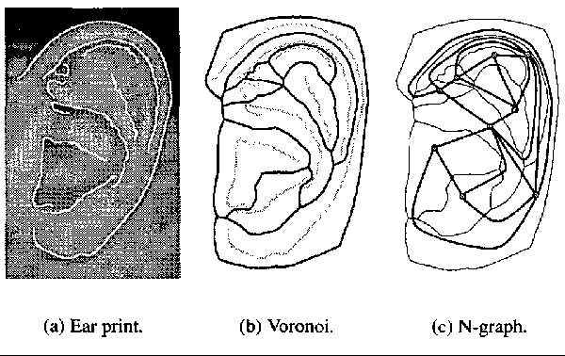
High level overview of Ear Recognition
Localization of ear in image
Convert
Notes:
First a persons image is taken ,
Then it's cast to a 300 by 500 greyscale image
Localization of the ear in the image is to be found
Ear is located using deformable contours on a gaussian pyramid representation of the image gradient
Edge extraction Canny Edge detector sigma = 3.0 and thresholding with hysteresis of 46 and 20
Edge relaxation happens, where in smaller curvature is ignored
Voronoi diagram of the curves are hence built.
This is stored in the database for future retrieval

Slide 60
Pros and Cons of Ear Scan
Combines visual as well as acoustic recognition techniques.
Ear is a 3 dimensional structure resistant to change due to age.
Everyone has a unique set of ears.
Not enough research done in the field
Acoustics aren’t reliable for authentication.
Hair is often an issue.
Not as reliable as the other methods of recognition. (i.e. iris and retina)
Notes:
The capillaries in the iris and retina decompose too rapidly to use a amputated eye to gain access

Slide 61
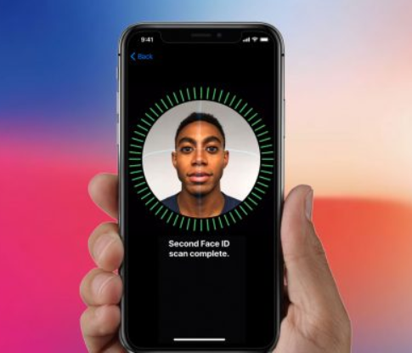
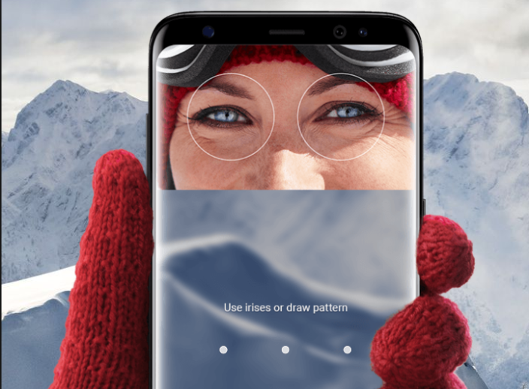
iPhone X
Samsung Galaxy S8

Slide 62
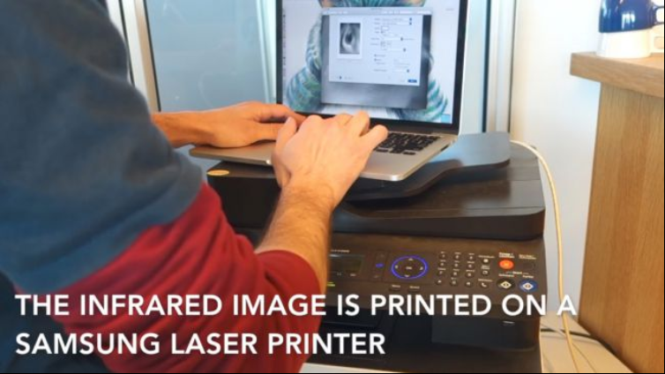
Samsung Galaxy S8 Hack
Notes:
-High resolution photo of the victim
-A lazer printer for a photo cropped to their eye
-Using this an infrared version of the image is printed specific to the eye
-Contact lens is placed on top of the infrared image to emulate curvature

Slide 63
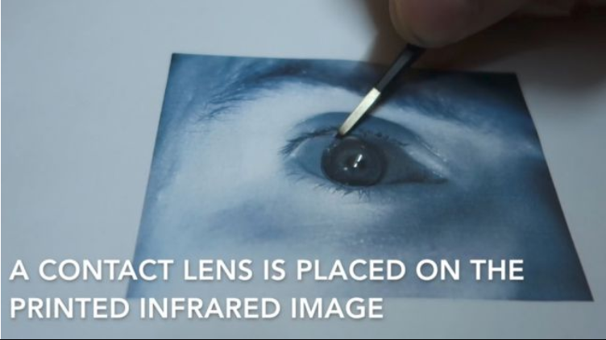
Samsung Galaxy S8 Hack

Slide 64
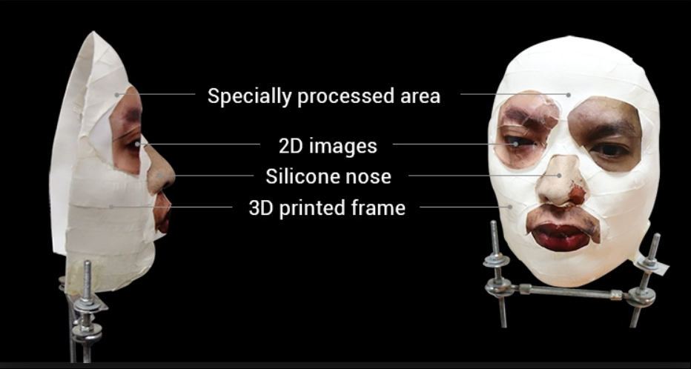
iPhone X faceID Hack
Notes:
A mask using the exact dimention of the victim's face has to be created,
This is done using a 3d printer,
Then 2D high resolution images of the persons eye region nose region and the mouth region are printed onto the 3d model of the face, then the mask also needs to be made with a special undisclosed material to beat the face scanner of apple's faceID

Slide 65
Citations
A Survey on Ear Biometrics - by AYMAN ABAZA, WVHTC Foundation ARUN ROSS, West Virginia University CHRISTINA HEBERT, and MARY ANN F. HARRISON, WVHTC Foundation MARK S. NIXON, University of Southampton.
Iris recognition system - technical overview. By :- Elijah Omidiora Ladoke Akintola University of Technology, Falohun A.s Ladoke Akintola University of Technology, John Ojo Ladoke Akintola University of Technology.
https://www.techradar.com/news/samsung-galaxy-s8-iris-scanner-hack .
https://resources.infosecinstitute.com/retinal-recognition-ultimate-biometric/
https://biometrictoday.com/25-advantages-disadvantages-iris-recognition/
Daugman, G. J., (2002). How iris works. Proceedings of 2002 International Conference on Image Processing.(ICIP), pp 1.33 -1.36.
Xinchao Wang - Computer Vision Lecture Slide 1.

Slide 66
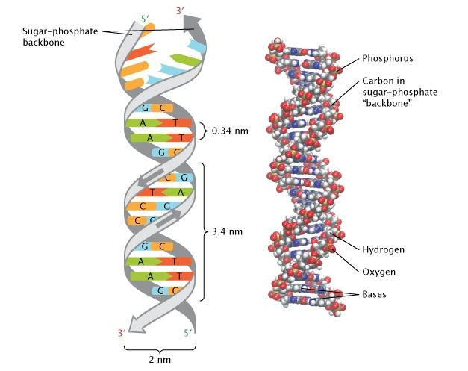
DNA Authentication and Encryption
Michael Fang
1) How to Read?
2) How to Secure it?
https://www.nature.com/scitable/topicpage/discovery-of-dna-structure-and-function-watson-397

Slide 67
DNA for Authentication
Advantages:
Ultimate Unique Identifier: Even identical twins (monozygotic) can be discriminated by their Short Tandem Repeats
Stable: While epigenetic factors change, DNA is relatively stable over the course of an individual’s lifetime (Bjornsson)
Disadvantages:
Not currently practical for end-user for daily authentication requirements.
Not perfectly stable. (DNA damage repair, mutation, cancer) (~64 mutations over an average human’s lifetime (Clark))
Significant security (and ethical?) issues.
Notes:
Stuff in case someone asks!
Why Unique?
independent assortment (selection of one allele does not affect selection of another - only somewhat true d/t genetic linkage)
exchange of genes (chromosomal crossover during sexual reproduction)
mutations!
Variations:
Gross alterations (chromosomal abnormalities) are, in general, incompatible with life; apart from sex chromosomal anomalies, live birth extra autosomal chromosomes are 21, 18, 13 (Downs, Edwards, Patau Syndrome). Thus we care about *variations*, or nucleotide diversity, when attempting to distinguish 2 individuals.
~2,100 to 2,500 structural variations, which include approximately 1,000 large deletions, 160 copy-number variants, 915 Alu insertions, 128 L1 insertions, 51 SVA insertions, 4 NUMTs, and 10 inversions.
Short Tandem Repeats:
microsatelite of 2-13 nucleotides repeated several dozen times in a row; varies for individuals.
The probability of two individuals sharing the same sequence of A B and C, where each are independent loci, is 1 in a quintillion (1x10^18).
In practice, probability is much higher due to false positives, contamination, and identical (monozygotic) twin sequences, so multiple control samples are necessary.

Slide 68
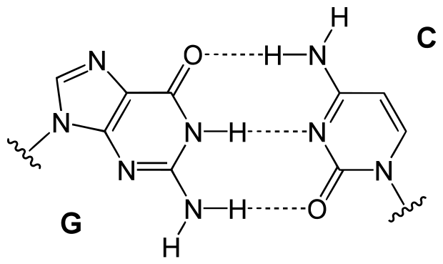
DNA For CS
Background:
Human DNA is a nucleic acid sequence (string) with ~3.088 billion base pairs (letters)
RNA Sequence: AUG-UUU-ACA-CAU-GGU-UGG-GUA-UAG
Codes: START, Phe, Thr, His, Gly, Trp, Val STOP
Only ~90,000 base pairs are coding, the rest are non-coding (either ‘nonsense’ or structural/epigenetic)
All human variation occurs within just 0.5% of the genome and individuals differ by between ~0.1% (Abecasis) to 0.6% (Auton) of their genome [~20 million base pairs].
Side-note: identical twins have the same DNA sequences but different copy number-variations!
Only 4 ‘letters’, (Adenosine, Cytosine, Guanine, Thymine) => 2-bits to encode
~750mb to encode entire individual’s genome.
~4mb to encode person’s ‘variation’ compared to a baseline standard (Christley).
https://upload.wikimedia.org/wikipedia/commons/6/64/Base_pair_GC.svg
Notes:
It’s 3 billion base pairs, but remember, DNA is a double strand, so there are 6 billion base pairs total in the human genome

Slide 69
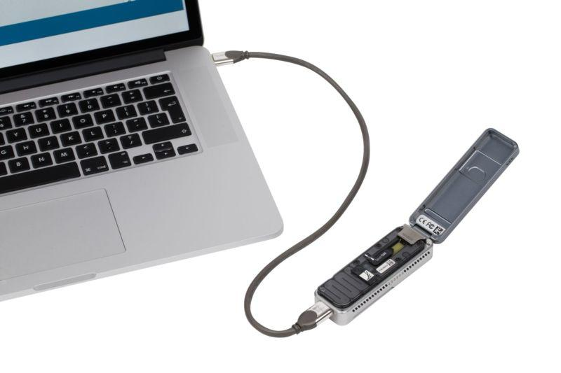
DNA Authentication
Authentication Methods - Goals:
DNA sequencing: require >99.9% accuracy!
First “generation” machines measured ‘weight’ of DNA base pairs to estimate sequences
Second generation take 1 day to 1 week to sequence
Third generation can do run 30 min-20 hrs, achieve >99.999% accuracy (Shendure)
Problems:
Needle-in-a-stack-of-Needles problem.
Short sequence needs to be replicated so to be large enough to be read: PCR amplification issues.
Faster machines are more expensive to purchase and to run
Longer strands are desirable (fewer passes required for completeness), but more difficult to accomplish
Preparation of DNA slides is not feasible for public use at this time.
https://arstechnica.com/science/2018/01/pocket-sized-dna-reader-used-to-scan-entire-human-genome-sequence/
Notes:
Major hurdles:
most of us share the same code for vast majorities of genome, but *how* they are encoded may be slightly different (copy number variants), so discriminating between two sequences is like finding a needle in a stack of needles.
many commercial DNA sequencing companies cannot even discriminate between human and canine DNA.
As of now, it is a NP-complete problem to determine protein folding based on a particular sequence, and also not feasible to guess a sequence based on result because there are major gaps in the understanding of how different motifs in a sequence affect the final form of a protein.

Slide 70
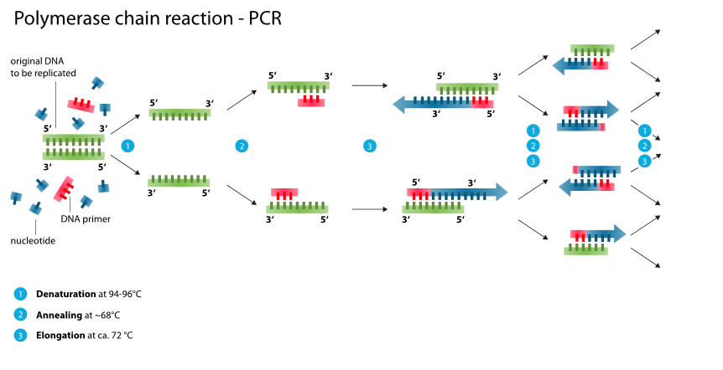
DNA Authentication Techniques
https://en.wikipedia.org/wiki/Polymerase_chain_reaction#/media/File:Polymerase_chain_reaction.svg

Slide 71
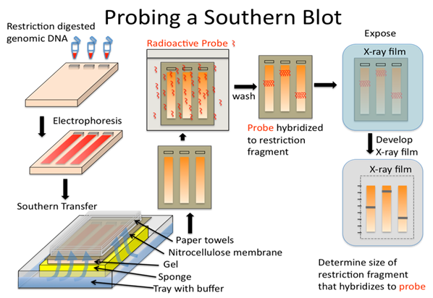
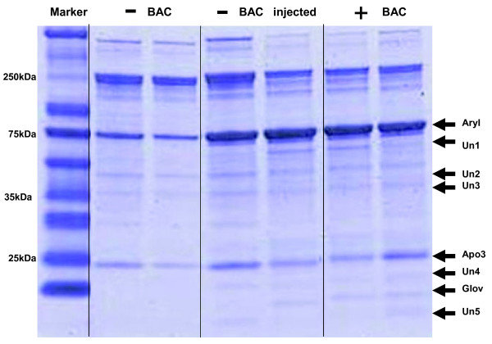
DNA Authentication Techniques
Southern Blotting:
https://files.mtstatic.com/site_4463/5358/0?Expires=1555618818&Signature=BMTA28w7~0CV9yj51bWazd~eCzi5iPz6UXpQWDhIrOJHyJ3m6aC1k6H0CrxQ~ulAT7EHugbbILnhWK758nnCrR3f3npPEtQTKC2zheGDWRPtd4sjdY7n2XaJXkdVOVHCqXDboXMPJ~hWw1gIRL35y0aywx4H7m1F~e4lPHqQze4_&Key-Pair-Id=APKAJ5Y6AV4GI7A555NA

Slide 72
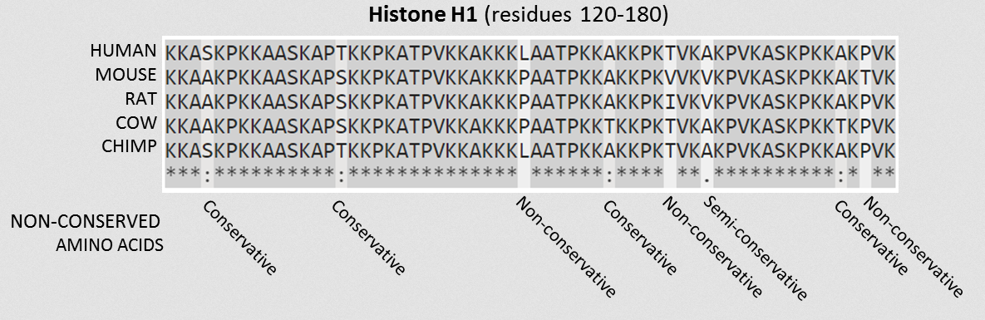
DNA Authentication Techniques
Edit Distance, Dot-Matrix, Base Calling:
how dissimilar are two strings?
Insertion, Deletion, Substitution
https://en.wikipedia.org/wiki/Sequence_alignment#/media/File:Histone_Alignment.png
Notes:
Software: BLAST, FASTA3x, T-Coffee, ClustalW2
Full analysis too slow, too unwieldy, and too expensive for things like logging onto a computer!
Can we sequence random strings and compare chance of variation? (maybe)
Base Calling - assigning nucleobases to chromatogram peaks - Phred base-calling, using Charged-Coupled Device

Slide 73
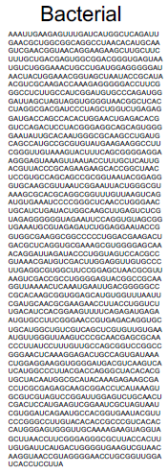
DNA Encryption
Why should we bother to encrypt our DNA?
1) Personal Authentication
Authentication of DNA is outsourced to low-cost commercial clouds.
2) Personal Health Security (pre-existing conditions)
3) Family Health Security (ex: family history of high cholesterol)
4) Secreting dangerous sequences (Ebola, Zika, Smallpox)
5) Protection from our own ‘understanding’
- ex: carriers of sickle cell anemia have resistance against malaria.
Alleles occur at different rates in different populations.
Notes:
DNA analysis requires ‘read mapping’ a ‘reference’ genome, which requires aligning millions of short sequences. This requires calculation of edit distances for 10^6-10^9 base pairs.

Slide 74
DNA Encryption
Some things to keep in mind:
Possible Known-plaintext attack (KPA) - Most of the data is full of known sequences
Methodologies:
Cryfa - encryption protocol specific for genomic data (Hosseini)
AES used on top of compression scheme.
form tuple of blocks of DNA with headers for positions
relatively efficient (uses ~10-31MB)
DNA Lock (Bancroft & Clelland)
embed data within a DNA sequence, which can be retrieved later via PCR
Without primer sequence, cannot determine start of replication or frame shift

Slide 75
Works Cited
Auton A, Brooks LD, Durbin RM, Garrison EP, Kang HM, Korbel JO, et al. (October 2015). "A global reference for human genetic variation". Nature. 526 (7571): 68–74. Bibcode:2015Natur.526...68T. doi:10.1038/nature15393. PMC 4750478. PMID 26432245.
Bancroft et. al. “Long-Term Storage of Information in DNA.” Science. 293, pp 1763-1765 (2001)
Bjornsson et al. Journal of the American Medical Association. 25 July 2008. Johns Hopkins Medical Institution.
Chen, Yangyi; Peng, Bo; Wang, XiaoFeng; Tang, Haixu (2012). “Large-Scale Privacy-Preserving Mapping of Human Genomic Sequences on Hybrid Clouds”. School of Informatics and Computing, Indiana University.
Christley, Scott; Lu, Yiming; Li, Chen; Xie, Xiaohui (2009). "Human genomes as email attachments". Bioinformatics. 25 (2): 274–275. doi:10.1093/bioinformatics/btn582. ISSN 1460-2059.
Drake JW, Charlesworth B, Charlesworth D, Crow JF (April 1998). "Rates of spontaneous mutation". Genetics. 148 (4): 1667–86. PMC 1460098. PMID 9560386.
Hosseini, Morteza; Pratas, Diogo; Pinho, Armando J. (2018). “Cryfa: a secure encryption tool for genomic data”. Bioinformatics. 35 (1): 146-158. doi: 10.1093/bioinformatics/bty645.
"Human Genome Project Completion: Frequently Asked Questions". National Human Genome Research Institute (NHGRI). Retrieved 2019-03-29.
Shendure J, Porreca GJ, Reppas NB, Lin X, McCutcheon JP, Rosenbaum AM, Wang MD, Zhang K, Mitra RD, Church GM (9 Sep 2005). "Accurate multiplex polony sequencing of an evolved bacterial genome". Science. 309 (5741): 1728–32. Bibcode:2005Sci...309.1728S. doi:10.1126/science.1117389. PMID 16081699.
https://www.news-medical.net/news/20171130/New-software-could-make-real-time-DNA-authentication-a-reality.aspx

